Slide 1
Proof and explanation for: cos( a + b ) = cos(a) . cos(b) – sin(a) . sin(b)
and
sin( a + b ) = sin(a) . cos(b) + cos(a) . sin(b)

Slide 2
Y
Here we have
angles ‘a’ and ‘b’
b
a
X

Slide 3
Y
(x’, y’)
And here we have the coordinates (x,y) for angle ‘a’
And coordinates (x’,y’) for angle ‘b’
Note we are also highlighting the length of x, x', y, and y' against their respective axis
y’
y
(x, y)
b
a
x’
x
X

Slide 4
Y
v2
(x,y) can also be interpreted as a vector 'v1'.
Vector 'v1' has its origin at (0,0) and end at (x,y)
Similarly, we can draw the same assumptions with (x',y'), making it vector 'v2'
And they all have the same length (magnitude).
(x’, y’)
y’
v1
y
(x, y)
b
a
x’
x
X

Slide 5
Y
v2
'v1' is a vector in which a rotation of 'a' degrees was applied
'v2' can be thought of 'v1' but applying an additional 'b' degrees of rotation Note that this transforms the coordinates of (x,y) to (x',y')
(x’, y’)
y’
v1
y
(x, y)
b
a
x’
x
X

Slide 6
Y
v2
And since they are vectors of same magnitude, their radius 'r' is the same
(x’, y’)
y’
r
v1
y
(x, y)
r
b
a
x’
x
X

Slide 7
Y
v2
(x’, y’)
y’
Considering the angle 'a' and the radius 'r' we have:
cos(a) = adjacent / hypotenuse -> cos(a) = x / y
sin(a) = opposite / hypotenuse -> sin(a) = y / r
And...
cos(a) = x / r -> x = cos(a) * r
sin(a) = y / r -> y = sin(a) * r
r
v1
y
(x, y)
r
b
a
x’
x
X

Slide 8
Y
v2
(x’, y’)
y’
And then we apply the same procedure to find what is the result of applying a rotation of 'a' degrees and then an additional rotation of 'b' degrees
cos(a + b) = x' / r -> x' = r * cos(a + b)
sin(a + b) = y' / r -> y' = r * sin(a + b)
r
v1
y
(x, y)
r
b
a
x’
x
X

Slide 9
Y
v2
(x’, y’)
y’
Since we have :
x' = r * cos(a + b)
and
y' = r * sin(a + b)
We will apply the 'angle addition formula for cosine' and 'angle addition formula for sine'
r
v1
y
(x, y)
r
b
a
x’
x
X

Slide 10
Y
v2
(x’, y’)
y’
Angle addition formula for cosine:
x' = r * cos( a + b) ->
x' = r * ( cos(a)*cos(b) - sin(a)*sin(b) )
x' = r * cos(a) * cos(b) - r * sin(a) * sin(b)
But since: x = r * cos(a) and y = r * sin(a)
We replace these parts in the formula and we will end up with:
x' = x * cos(b) - y * sin(b)
r
v1
y
(x, y)
r
b
a
x’
x
X

Slide 11
Y
v2
(x’, y’)
y’
Similarly, we will do the same for the Angle addition formula for sine:
y' = r * sin( a + b ) ->
y' = r * ( sin(a) * cos(b) + cos(a) * sin(b) )
y' = r * sin(a) * cos(b) + r * cos(a) * sin(b)
But since: x = r * cos(a) and y = r * sin(a)
We replace these parts in the formula and we will end up with:
y' = y * cos(b) + x * sin(b)
r
v1
y
(x, y)
r
b
a
x’
x
X

Slide 12
Y
v2
(x’, y’)
y’
Therefore:
x' = x * cos(b) - y * sin(b)
y' = y * cos(b) + x * sin(b)
r
v1
y
(x, y)
r
b
a
x’
x
X

Slide 13
Y
v2
(x’, y’)
y’
Now, if we want to rotate it in 3D we follow this:
Z-axis rotation:
x' = x * cos(b) - y * sin(b)
y' = x * sin(b) + y * cos(b)
z' = no change
Y-axis rotation:
x' = x * cos(b) - z * sin(b)
y' = no change
z' = x * sin(b) + z * cos(b)
X-axis rotation:
x' = no change
y' = y * cos(b) - z * sin(b)
z' = y * sin(b) + z * cos(b)
r
v1
y
(x, y)
r
b
a
x’
x
X

Slide 14
Y
Proof that: sin( a + b ) = sin(a) * cos(b) + cos(a) * sin(b)
D
1
sin( a + b )
r = 1
E
C
a
b
A
F
B
X

Slide 15
Y
Note that we have the triangles: A,B,C for angle ‘b’ A,C,D for angle ‘a’ A,F,D for angle (a + b) and we are going to try to proof that the side FD is the sin( a + b)
D
1
sin( a + b )
r = 1
E
C
a
b
A
F
B
X

Slide 16
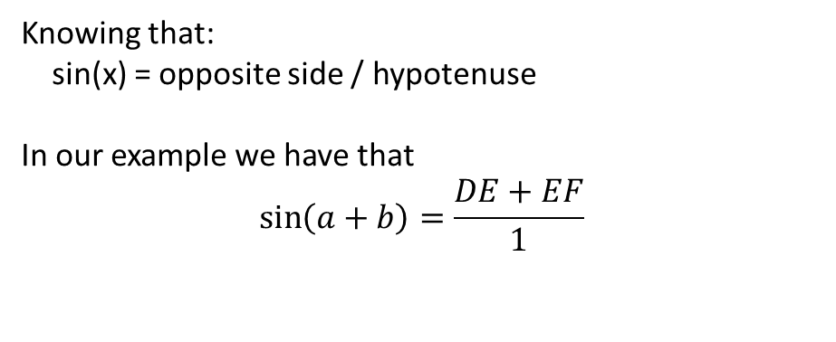
Y
D
Knowing that: sin(x) = opposite side / hypotenuse In our example we have that
$$\sin\left(a+b\right)=\frac{DE+EF}{1}$$
sin( a )
1
sin( a + b )
r = 1
E
C
cos(a)
a
b
A
F
B
X

Slide 17
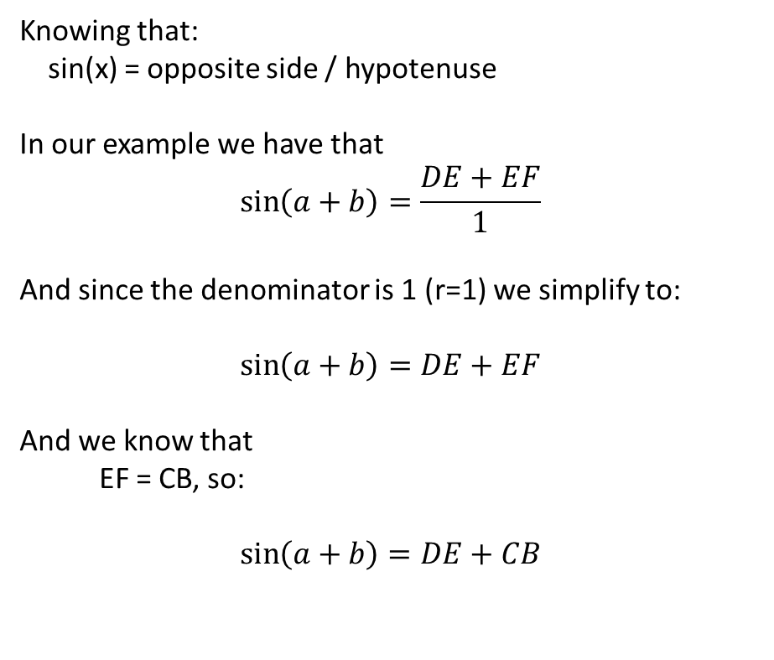
Y
D
Knowing that: sin(x) = opposite side / hypotenuse In our example we have that
$$\sin\left(a+b\right)=\frac{DE+EF}{1}$$ And since the denominator is 1 (r=1) we simplify to:
$$\sin\left(a+b\right)=DE+EF$$ And we know that EF = CB, so: $$\sin\left(a+b\right)=DE+CB$$
sin( a )
1
sin( a + b )
r = 1
E
C
cos(a)
a
b
A
F
B
X

Slide 18
Y
D
And we also know from trigonometry that CD = sin(a) and that AC = cos(a)
sin( a )
1
sin( a + b )
r = 1
E
C
cos(a)
a
b
A
F
B
X

Slide 19

Y
D
And we also know from trigonometry that CD = sin(a) and that AC = cos(a)
We can also define: $$\sin\left(b\right)=\frac{CB}{cos⁡(a)}$$
sin( a )
1
sin( a + b )
r = 1
E
C
cos(a)
cos(a)
a
b
A
F
B
X

Slide 20
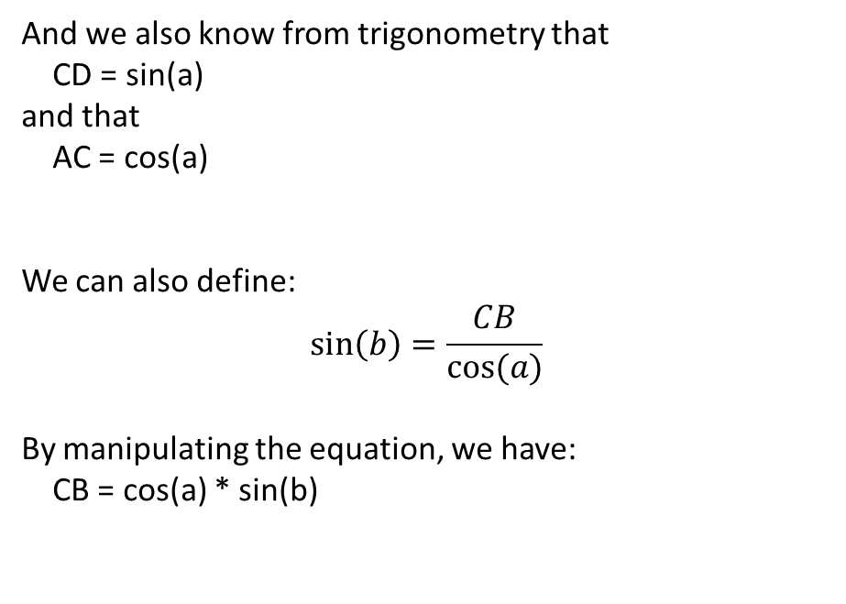
Y
D
And we also know from trigonometry that CD = sin(a) and that AC = cos(a)
We can also define: $$\sin\left(b\right)=\frac{CB}{cos⁡(a)}$$ By manipulating the equation, we have: CB = cos(a) * sin(b)
sin( a )
1
sin( a + b )
r = 1
E
C
cos(a)
a
b
A
F
B
X

Slide 21
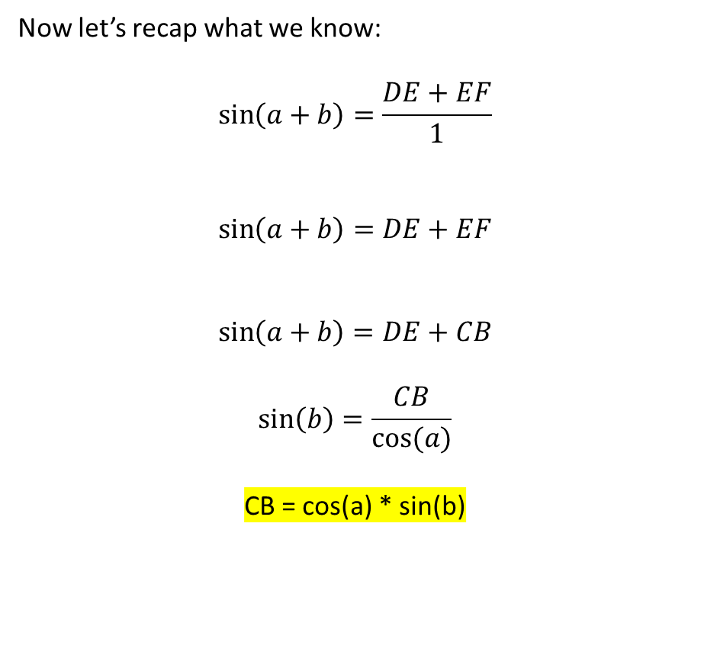
Y
D
Now let’s recap what we know:
$$\sin\left(a+b\right)=\frac{DE+EF}{1}$$
$$\sin\left(a+b\right)=DE+EF$$
$$\sin\left(a+b\right)=DE+CB$$
$$\sin\left(b\right)=\frac{CB}{cos⁡(a)}$$
CB = cos(a) * sin(b)
sin( a )
1
sin( a + b )
r = 1
E
C
cos(a)
a
b
A
F
B
X

Slide 22
Y
D
Now let’s recap what we know:
CB = cos(a) * sin(b)
And considering:
sin( a + b ) = sin(a) * cos(b) + cos(a) + sin(b)
We have:
sin( a + b ) = sin(a) * cos(b) + CB
sin( a )
1
sin( a + b )
r = 1
E
C
cos(a)
a
b
A
F
B
X

Slide 23
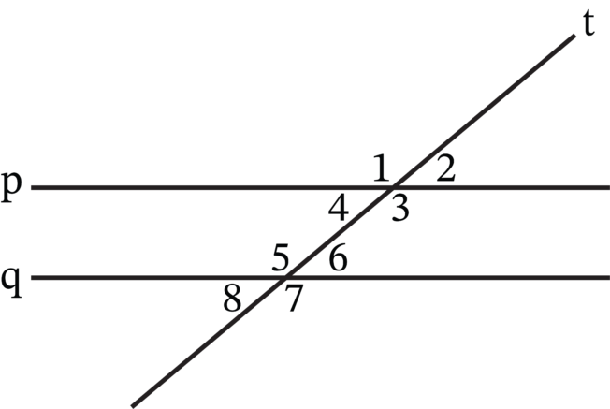
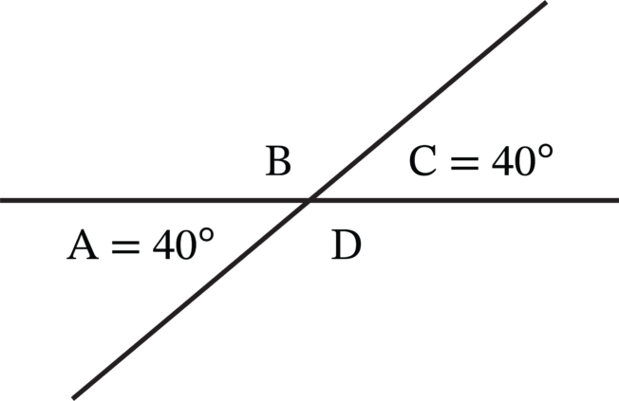
Now consider this:
And this:
Note that: “A close look at these intersections reveals that they are identical to each other. Because p and q are parallel, their intersections with t form congruent angles. So, not only are angles 1 and 3 congruent, but angles 5 and 7 are also included in this same congruence. Likewise, angles 2, 4, 6, and 8 are all congruent.”
- https://www.mometrix.com/academy/congruent-angles/

Slide 24
Y
D
Using the same properties listed before we can now find the most obvious congruent angles. As indicated below
sin( a )
1
sin( a + b )
r = 1
b
E
C
b
cos(a)
a
b
b
A
F
B
X

Slide 25
Y
D
Since the sum of all internal angles of a triangle is 180° we have: 90 + (90 - b) + ? = 180
90 + 90 – b + ? = 180
180 – b + ? = 180
-b + ? = 180 – 180
-b + ? = 0
? = b
?
sin( a )
1
sin( a + b )
r = 1
(90 – b)
b
E
90
C
b
cos(a)
a
b
b
A
F
B
X

Slide 26
Y
D
Since the sum of all internal angles of a triangle is 180° we have: 90 + (90 - b) + ? = 180
90 + 90 – b + ? = 180
180 – b + ? = 180
-b + ? = 180 – 180
-b + ? = 0
? = b
b
sin( a )
1
sin( a + b )
r = 1
(90 – b)
b
E
90
C
b
cos(a)
a
b
b
A
F
B
X

Slide 27
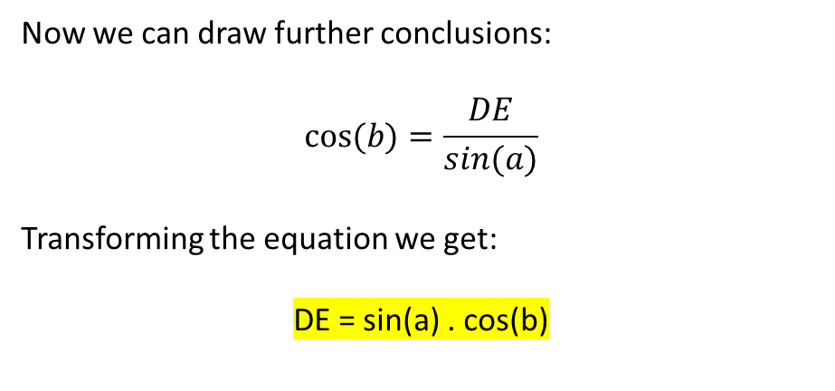
Y
D
Now we can draw further conclusions:
$$cos⁡(b)=\frac{DE}{sin⁡(a)}$$
Transforming the equation we get:
DE = sin(a) . cos(b)
b
sin( a )
1
sin( a + b )
r = 1
(90 – b)
E
90
C
b
cos(a)
a
b
A
F
B
X

Slide 28
Y
D
And by extension:
DE = sin(a) . cos(b)
sin( a + b ) = sin(a) * cos(b) + CB
sin( a + b ) = DE + CB
And with this we finalized the sin( a + b ) proof
b
sin( a )
1
sin( a + b )
r = 1
(90 – b)
E
90
C
b
cos(a)
a
b
A
F
B
X

Slide 29
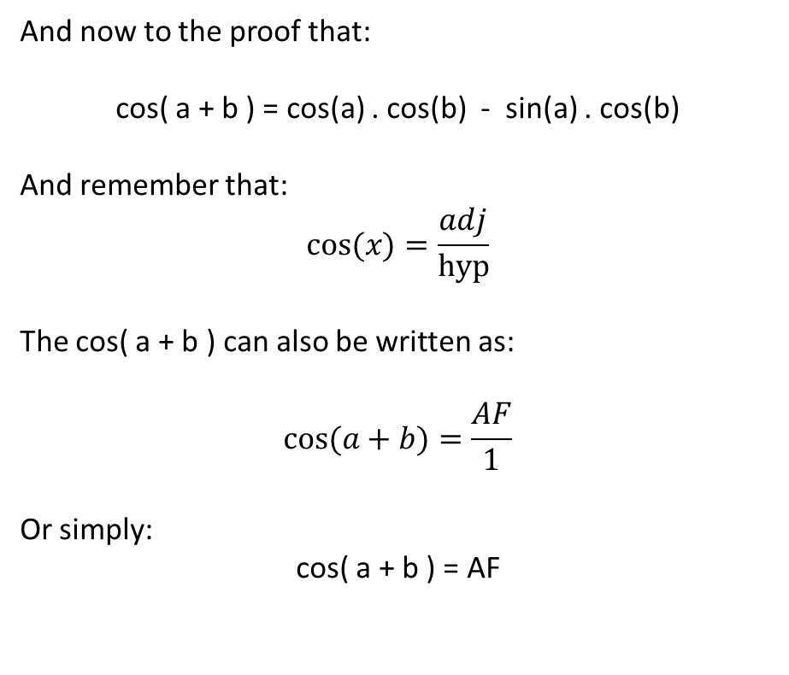
Y
D
And now to the proof that:
cos( a + b ) = cos(a) . cos(b) - sin(a) . cos(b)
And remember that:
$$cos⁡(x)=\frac{adj}{hyp}$$
The cos( a + b ) can also be written as:
$$cos⁡(a+b)=\frac{AF}{1}$$
Or simply:
cos( a + b ) = AF
b
sin( a )
1
sin( a + b )
r = 1
(90 – b)
E
90
C
b
cos(a)
a
b
A
cos( a + b )
F
B
X

Slide 30

Y
D
Considering that
cos( a + b ) = AF
We can explore other ways to tackle this problem:
$$cos⁡(a+b)=\frac{AB −FB}{1}$$
cos( a + b ) = AB - FB
b
sin( a )
1
sin( a + b )
r = 1
(90 – b)
E
90
C
b
cos(a)
a
b
A
cos( a + b )
F
B
X

Slide 31
Y
D
Considering that
FB = EC
We can write:
cos( a + b ) = AB - EC
b
sin( a )
1
sin( a + b )
r = 1
(90 – b)
E
90
C
b
cos(a)
a
b
A
cos( a + b )
F
B
X

Slide 32
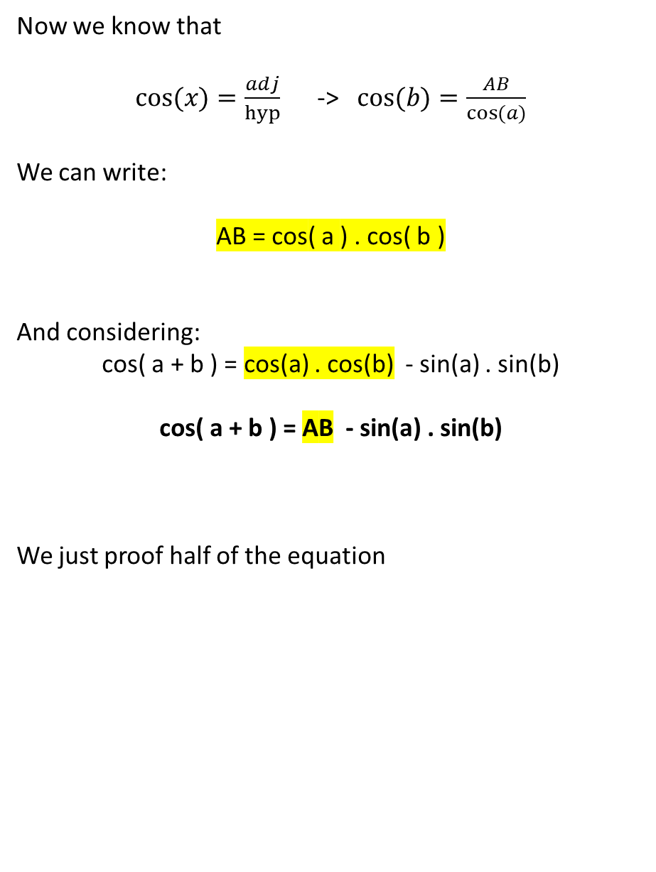
Y
D
Now we know that
$cos⁡(x)=\frac{adj}{hyp}$ -> $cos⁡(b)=\frac{AB}{cos⁡(a)}$
We can write:
AB = cos( a ) . cos( b )
And considering:
cos( a + b ) = cos(a) . cos(b) - sin(a) . sin(b)
cos( a + b ) = AB - sin(a) . sin(b)
We just proof half of the equation
b
sin( a )
1
sin( a + b )
r = 1
(90 – b)
E
90
C
b
cos(a)
a
b
A
cos( a + b )
F
B
X

Slide 33
Y
D
Considering our last proof:
cos( a + b ) = AB - sin(a) . sin(b)
And we want to prove that:
cos( a + b ) = AB - EC
We need to find evidence that:
EC = sin(a) . sin(b)
b
sin( a )
1
sin( a + b )
r = 1
(90 – b)
E
90
C
b
cos(a)
a
b
A
cos( a + b )
F
B
X

Slide 34
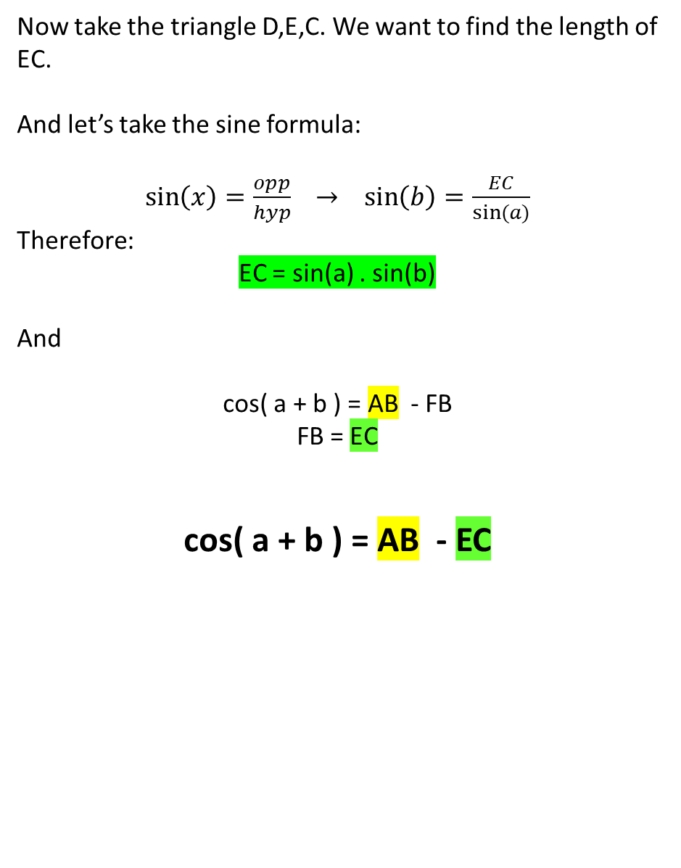
Y
D
Now take the triangle D,E,C. We want to find the length of EC. And let’s take the sine formula:
$\sin\left(x\right)=\frac{opp}{hyp}$ $→ \sin\left(b\right)=\frac{EC}{sin⁡(a)}$
Therefore:
EC = sin(a) . sin(b)
And
cos( a + b ) = AB - FB
FB = EC
cos( a + b ) = AB - EC
b
sin( a )
1
sin( a + b )
r = 1
(90 – b)
E
90
C
b
cos(a)
a
b
A
cos( a + b )
F
B
X

